Slide 1

Music Recommendation Service
Group 2: Jason Ingram, Isaiah Martinez
Notes:
1. Table of contents
2. Introduction
3. Quote
4. Study objectives
5. Literature review
6. Schedule
7. Methodology
8. Table
9. Results analysis
10. Conclusions
11. Bibliographical references

Slide 2
Table of contents
1) Dataset Overview
a) Data Visualization
b) Data Preparation
2) Models & Algorithms
3) Future Work
4) Conclusion

Slide 3
01
Data Overview

Slide 4


Data Overview
User and Music Data contained in several ‘Parquet’ files
Required an external library - Arrow
Turned into CSV

Slide 5
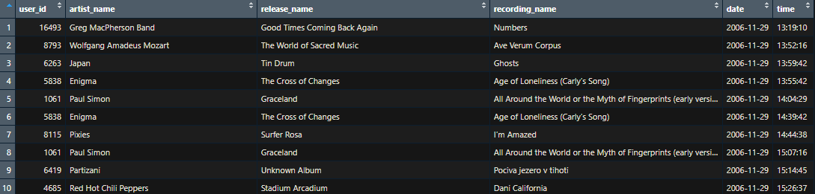
Dataset Visualization
First 10 entries from file

Slide 6
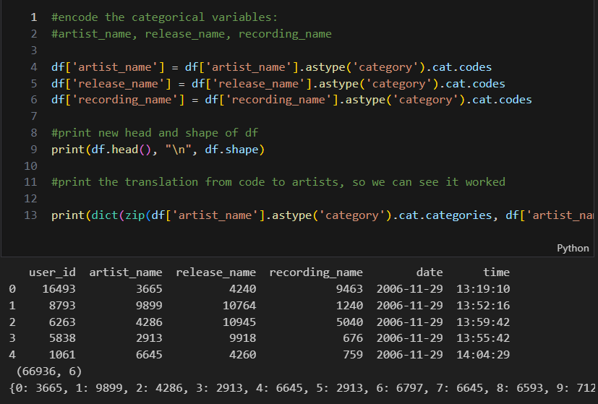
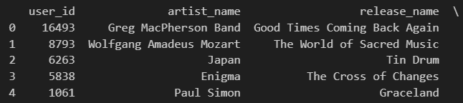
Data Preparation
Encoded each categorical column:

Slide 7
User Interaction Matrix
USERS \ ARTISTS | Artist 1 | Artist 2 | Artist 3
User 1 | 1 | 0 | 1
User 2 | 0 | 1 | 0
User 3 | 0 | 1 | 1

Slide 8
02
Models & Algorithms

Slide 9
Collaborative Filtering

Slide 10
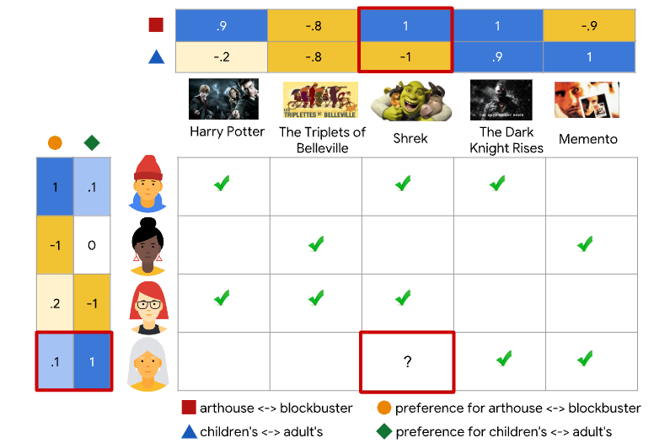
?

Slide 11
CF (ALS) - Overview
15K
20M
35%
Step 1
Step 2
Step 3
Analyze smaller k-sized matrices
Optimize User & Item matrices independently
Iterate until convergence

Slide 12
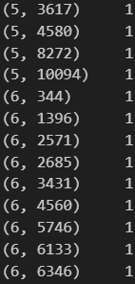
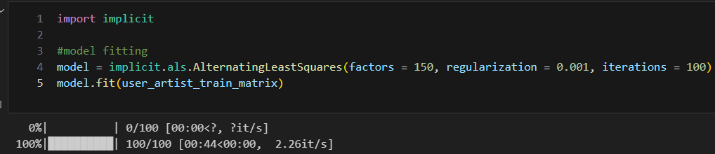
CF (ALS) – Code Explanation
Training
(User_ID, Artist)
Feeds into
Hyper-parameters:
Factors (k)
Regularization (λ)
Iterations
Alpha (not seen in the above image)

Slide 13
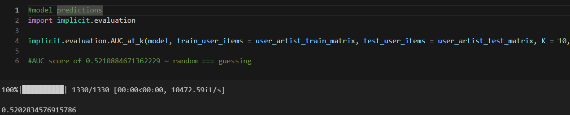
CF (ALS) – Code Explanation
Testing
Using AUC for performance
How to improve performance?
Grid Search

Slide 14
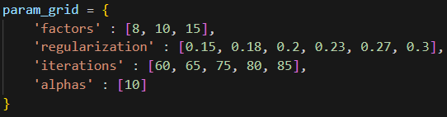
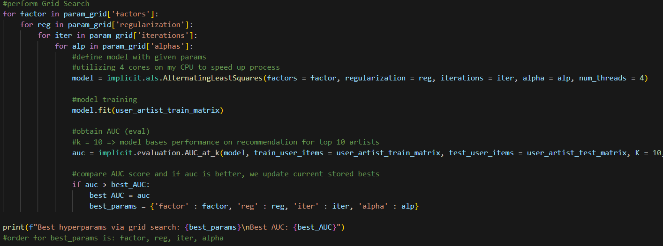
CF (ALS) – Code Explanation
Grid Search
Adjust all parameters to
improve performance

Slide 15

CF (ALS) – Performance Evaluation
~0.55 AUC score… Not good
Slightly better than randomly guessing

Slide 16
Take Aways from CF (ALS)
Fast
Easy Tuning
Poor Prediction
Avg run time on smaller dataset was < 5 mins per train and test
Grid Search allowed for highly varied values to be tried in sequence
Such a low AUC means it is not learning well. This would require many more iterations of Grid Search to find optimal solutions

Slide 17
Neural Collaborative Filtering

Slide 18
NCF – Overview
15K
20M
35%
Step 1
Step 2
Step 3
User Matrix and Item Matrix are fed. Then performs Dot product to create input matrix
Run through Hidden Layers
Output Binary Classifier (0;1) for interactions

Slide 19
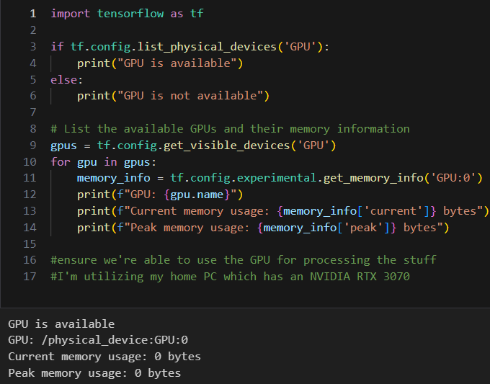
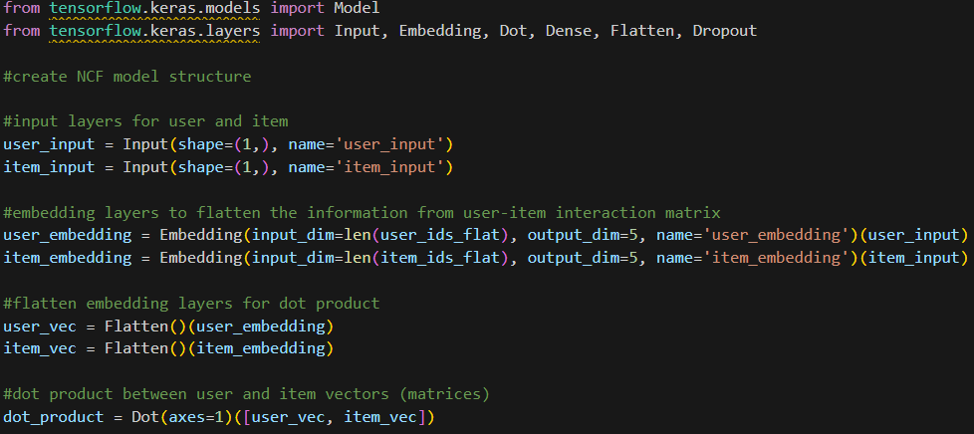
NCF – Code Explanation
Setup
Input → Embedding → Dot product
Use GPU for faster processing

Slide 20
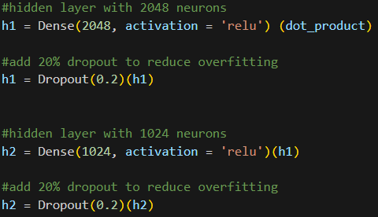
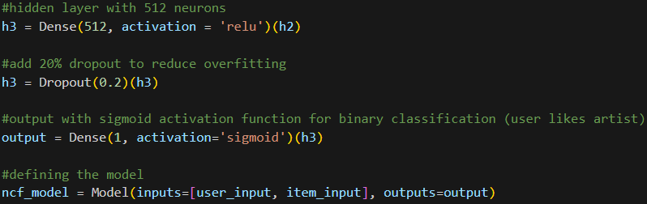
NCF – Code Explanation
Model Structure
Dot Product → Hidden layers 1 → 2 → 3 → output

Slide 21
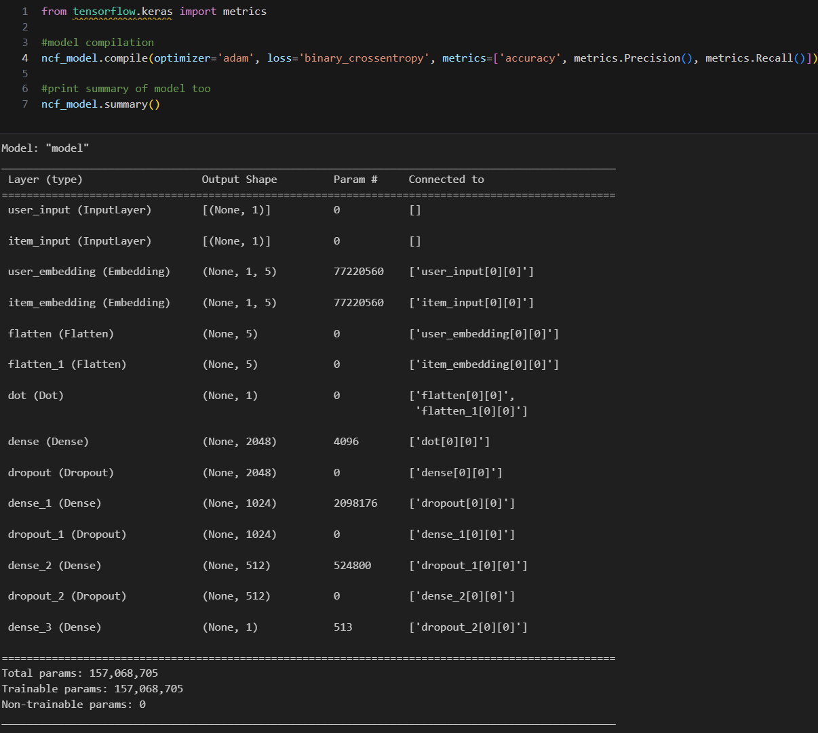
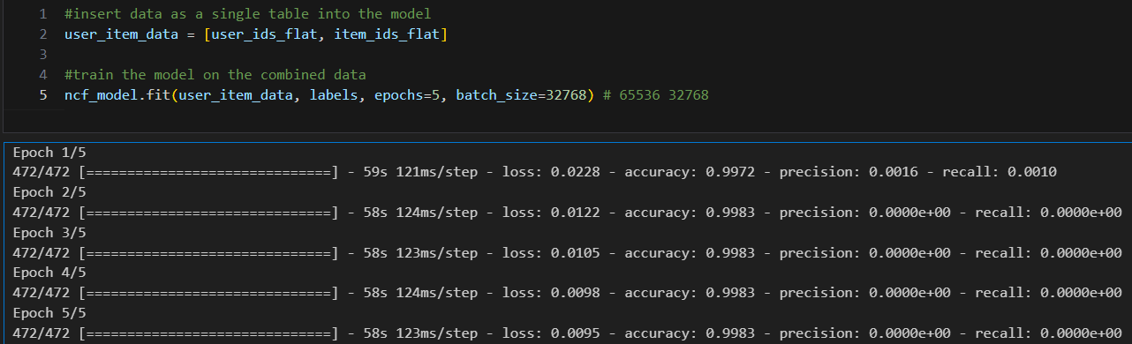
NCF – Code Explanation
Compile then Train model
Model Training
Note: I printed Precision and Recall to
get a better idea of performance
Model summary

Slide 22
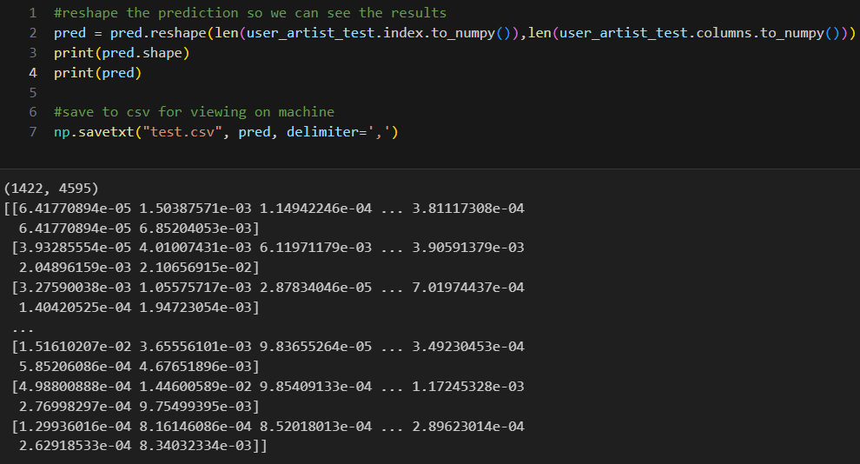
NCF – Performance Evaluation
Very low probability for interactions (< 0.2)

Slide 23
Take Aways from NCF
Slower than CF
High PC Req’s
Poor Learning
Despite me running many different models using both my CPU and GPU, NCF would run slower on average for training and testing
I frequently would run out of Memory (VRAM) when using the GPU. Using the CPU it would take many hours (>6 hours) per training session
High Accuracy but Extremely low Precision and Recall indicates model is overfitting

Slide 24
K-Nearest Neighbors

Slide 25
Algorithm - Overview
15K
20M
35%
Step 1
Step 2
Step 3
...
...
...

Slide 26
Algorithm - Explanation
Step 1

Slide 27
Algorithm - Explanation
Step 2

Slide 28
Algorithm - Explanation
Step 3

Slide 29
Algorithm – Performance Evaluation
...

Slide 30
Take Aways from Algorithm
Mercury
Venus
Despite being red, Mars is actually a cold place. It is the fourth planet from the Sun, right after Earth
Venus has a beautiful name but it’s terribly hot. It is the second planet from the Sun

Slide 31
03
Future Work

Slide 32
Future Work
Utilize Cloud Services for DL models
Obtain dataset with user ratings
Pick alternative algorithms
Utilize Hybrid Methods

Slide 33
04
Conclusion

Slide 34

Conclusion
This was a fun yet challenging project. Our models’ performance wasn’t great, but demonstrates the difficulty with building an implicit recommender system.

Slide 35
References
Neural Collaborative Filtering (2017) He, Liao, Zhang, et. al.
https://developers.google.com/machine-learning/recommendation/collaborative/basicshttps://developers.google.com/machine-learning/recommendation/collaborative/basics
https://towardsdatascience.com/alternating-least-square-for-implicit-dataset-with-code-8e7999277f4b
https://towardsdatascience.com/recommendation-system-matrix-factorization-d61978660b4b
AUTHOR (YEAR). Title of publication. Publisher

Slide 36

Thanks
Questions?
Thank you for your time
and attention
Please keep this slide for attribution

